Slide 1
Realtime Custom Object Detection & Recognition Implementation
Presenters:-
Arul Raj (1001704417)
Divya Saxena (1001773376)

Slide 2
The Life Cycle
Defining Project
Objectives
Deployment of
Model
Data
Preparation
Evaluation of
Model
Training
Model
Testing the
Model

Slide 3
Implementation Parts
We have developed 3 parts of the Realtime object detection and recognition, namely
Celebrity Face Recognition in real-time videos
Here the Input will be a video for a celebrity with which the network (CNN) is trained and output will be the video with bounding boxes and labels around the celebrity images.
COCO real-time object detection using YOLO
Here the Input will be an image or a video of common objects (COCO) that the YOLO is trained with and output will be the image or video with bounding boxes and labels around the objects.
Realtime object detection of input from webcam
Here the Input will be an image, or a video of an object captured using webcam by drawing bounding boxes, since the network YOLO has been trained with that in the process therefore, output will be the image or video with confidence labels.

Slide 4
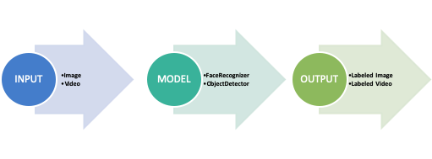
Process Flow
Supervised Training is executed, that is the training data is labeled using the YAT Annotation tool (as per the previous submission 2)
The input to the model will be an image or a video not from the training dataset.
The output will be the image or video having the bounding boxes with the labels around the corresponding object recognized as a part of this process.

Slide 5
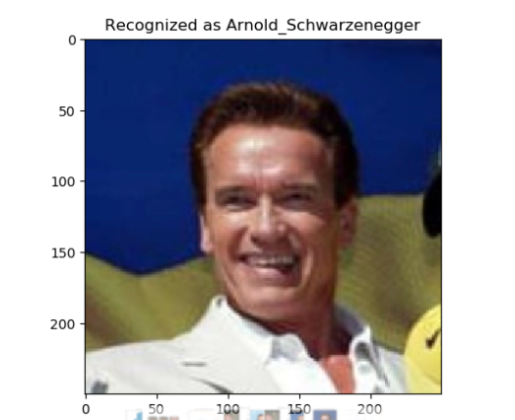
Celebrity Face Recognition
Implemented using Python libraries Keras, Dlib and OpenCV.
Face recognition using Keras is divided into 4 steps:
Detect/ Identify faces in an image using Dlib and OpenCV – (face alignment)
Convert image into grayscale and crop into 200X200 pixels
Design convolutional neural network using Keras
Train the model on the test model on testing data

Slide 6
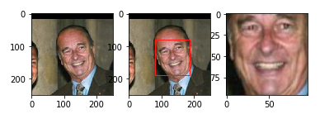
Celebrity Face Recognition- Face Alignment
The nn4.small2.v1 model was trained with aligned face images, therefore, the face images from the custom dataset must be aligned too.
Here, we have used Dlib for face detection and OpenCV for image transformation and cropping to produce aligned 96x96 RGB face images.

Slide 7
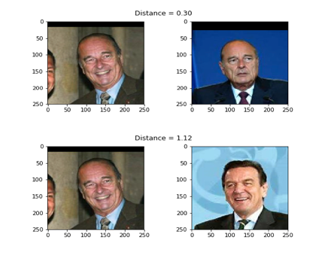
Celebrity Face Recognition- squared L2 distance
But we still do not know what distance threshold τ is the best boundary for making a decision between same identity and different identity.

Slide 8
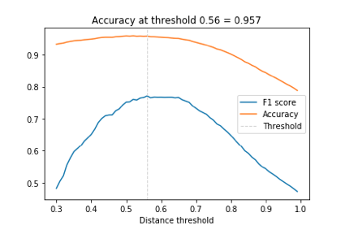
Celebrity Face Recognition- Accuracy
Since we have skewed data I.e. more negative pairs than positive pairs.
Therefore, we use F1 score as the evaluation metric rather than accuracy metric.

Slide 9
Celebrity Face Recognition- Accuracy
Once we have estimated the distance threshold τ in the previous step,
Face recognition is as simple as calculating the distances between an input embedding vector and all embedding vectors in a database.
But we have used a more robust approach for labelling the input
Using KNN classification with a Euclidean distance metric
a linear support vector machine (SVM) trained with the database entries and used to classify i.e. identify new inputs.
The accuracy for celebrity recognition using 1. K-NN 2. Support Vector Machines (SVM) is 96% and 98% respectively.

Slide 10
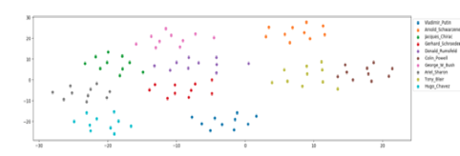
Celebrity Face Recognition- Dataset Visualization
To embed the dataset into 2D space for displaying identity clusters, t-distributed Stochastic Neighbor Embedding (t-SNE) is applied to the 128-dimensional embedding vectors.
Except from a few outliers, identity clusters are well separated.

Slide 11
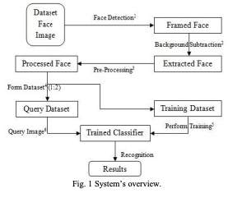
Celebrity Face Recognition- References
The reference we have followed for general ideas is about “Person Finder”
https://www.google.com/url?sa=t&rct=j&q=&esrc=s&source=web&cd=2&cad=rja&uact=8&ved=2ahUKEwjXi_L1jbvnAhVGIqwKHTJlDNQQFjABegQIAhAB&url=https%3A%2F%2Farxiv.org%2Fpdf%2F1302.6379&usg=AOvVaw3T9G28b-P1ECXauRR-dskp
What we have followed/used from this reference paper is the below flowchart.
And the Support Vector Machine classifier.
Extension:
Added the recognition feature for celebrities using neural networks with Keras.

Slide 12
COCO Realtime Multiple Object Detection
The COCO dataset is already pre-processed, therefore no need for pre-processing.
The dataset images or videos will be given as input to YOLO network that has been trained on COCO dataset.
The videos for input will be taken from the /videos folder in the project directory.
The output video with the bounding boxes with labels will be stored in the folder /output in the project directory.

Slide 13
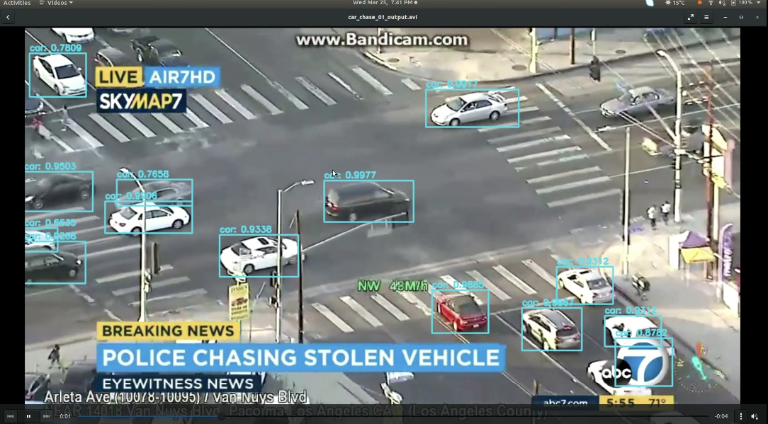
COCO Realtime Multiple Object Detection

Slide 14
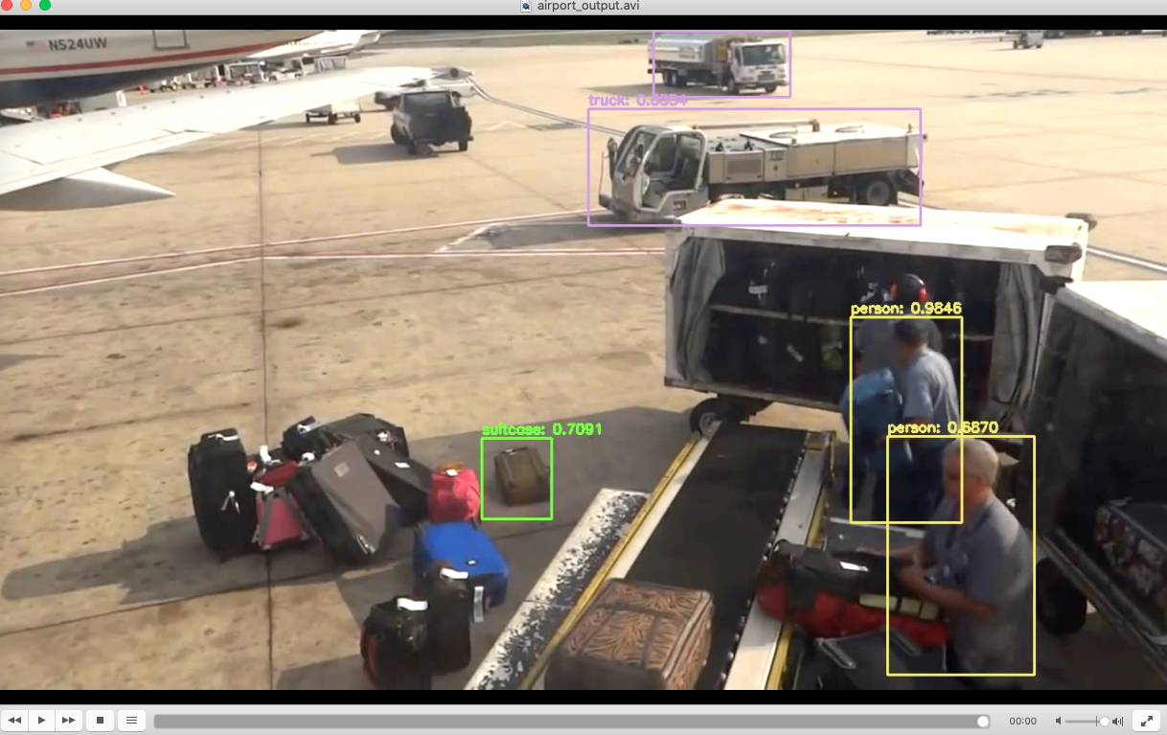
COCO Realtime Multiple Object Detection

Slide 15
Realtime Object Detection (Webcam)
The input will be captured by drawing the bounding boxes around the object to detect in real-time captured by the webcam.
The input will be the video or webcam (camera) whichever argument we supply at runtime.
The videos for input will be taken from the /videos folder in the project directory.
We can also change the trackers by supplying the relevant tracker IDs as outlined below,
csrt": cv2.TrackerCSRT_create
kcf": cv2.TrackerKCF_create
boosting": cv2.TrackerBoosting_create
mil": cv2.TrackerMIL_create,
tld": cv2.TrackerTLD_create
medianflow": cv2.TrackerMedianFlow_create
mosse": cv2.TrackerMOSSE_create

Slide 16
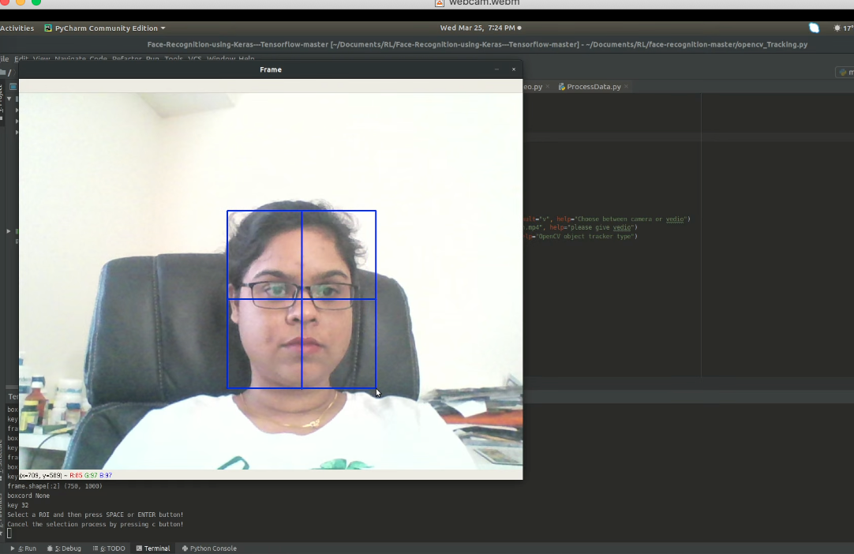
Realtime Object Detection (Webcam)

Slide 17
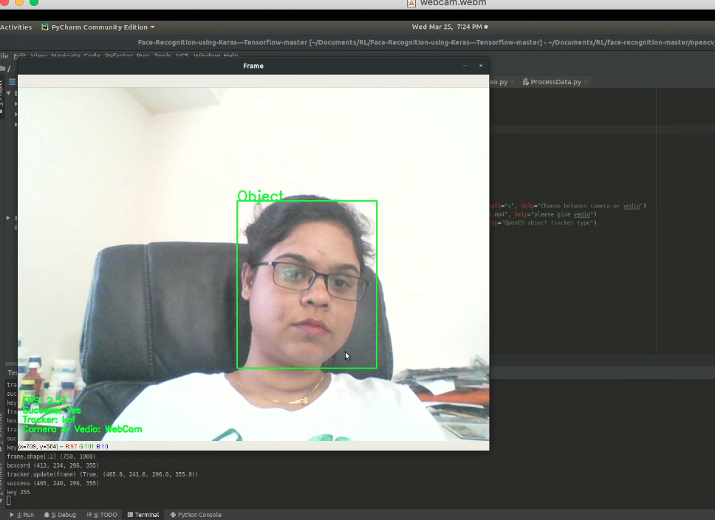
Realtime Object Detection (Webcam)

Slide 18
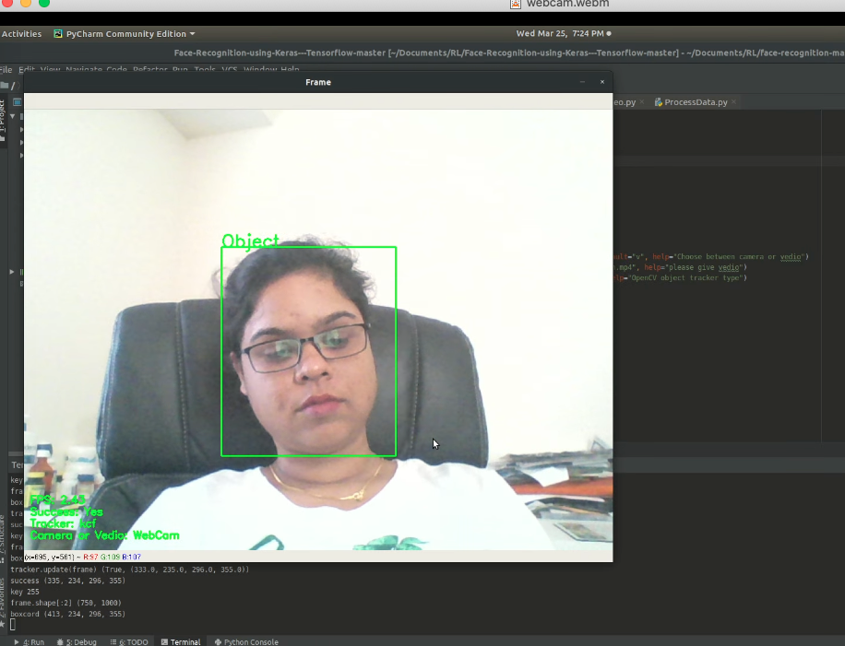
Realtime Object Detection (Webcam)

Slide 19
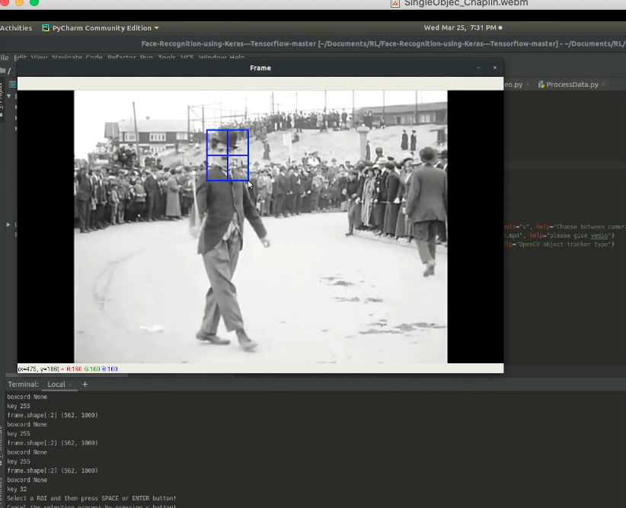
Realtime Object Detection (Webcam)

Slide 20
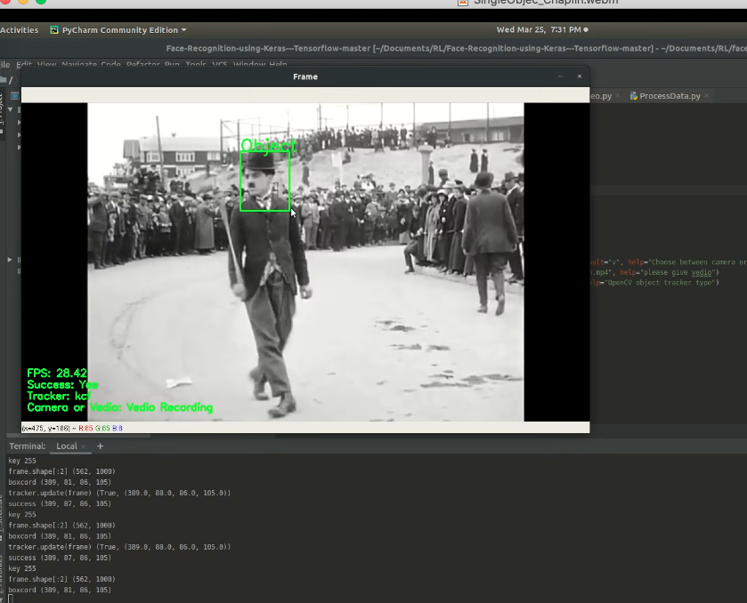
Realtime Object Detection (Webcam)

Slide 21


Timeline
February
Project scope evaluation.
March
Implementation phase begins.
April
Integrating the code for submission.
May
Final submission of project report
Framing project description.
Timeline setup
Clubbing references.
Data Preparation
Starting up data cleaning and preprocessing
Working on a little over the project report.
Evaluation phase starts.
Creating the project presentation.

Slide 22
Thank you !

